Slide 1
Lathe Operations
Lecture 21

Slide 2
Lathe
A lathe is a machine that removes metal from a piece of work to the required shape &size
➢ A lathe is one of the most important machine tools in the working industry. A lathe operates on the principle of a rotating workpiece and a fixed cutting tool.
➢ The cutting tool is feed into the workpiece, which rotates about its own axis, causing the workpiece to be formed to the desired shape.
Notes:
Engagement of entire blade into cutting need higher forces. Therefore, inclined blade is used to reduce force.

Slide 3
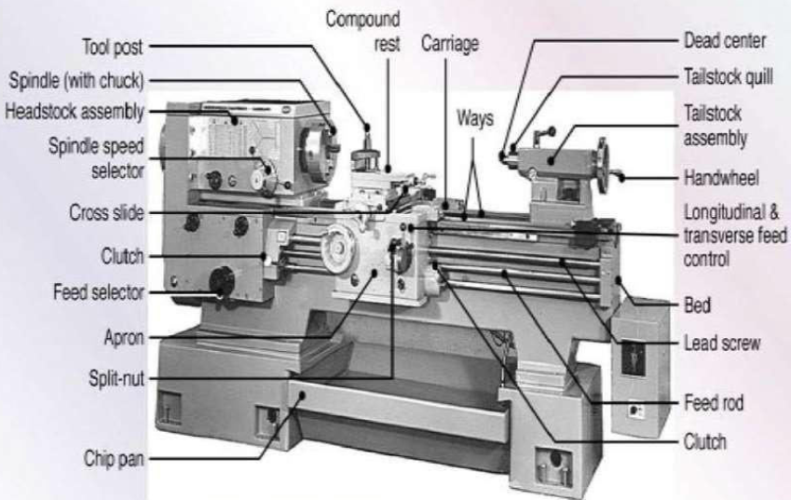
Pictorial View of Lathe (with various parts marked)
A lathe is a machine that removes metal from a piece of work to the required shape &size
Notes:
Engagement of entire blade into cutting need higher forces. Therefore, inclined blade is used to reduce force.

Slide 4
Lathe Operations:
(1) Facing
(2) Turning
(3) Taper turning
(4) Chamfering
(5) Knurling
(6) Grooving or Necking
(7) Threading
(8) Parting
(9) Drilling
(10) Boring
(11) Reaming
(12) Milling
(13) Grinding
Notes:
Engagement of entire blade into cutting need higher forces. Therefore, inclined blade is used to reduce force.

Slide 5
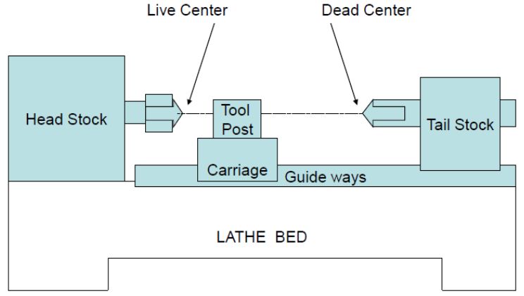
Pictorial View of Lathe (with various parts marked)
Notes:
Engagement of entire blade into cutting need higher forces. Therefore, inclined blade is used to reduce force.

Slide 6
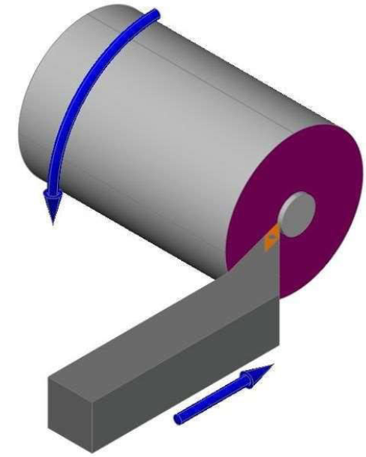
Facing
Facing: To produce a flat surface at the end of the part (i.e., at the face)
In the Facing operation, the Tool is fed at 90⁰ to the axis of rotation.
Notes:
Engagement of entire blade into cutting need higher forces. Therefore, inclined blade is used to reduce force.

Slide 7
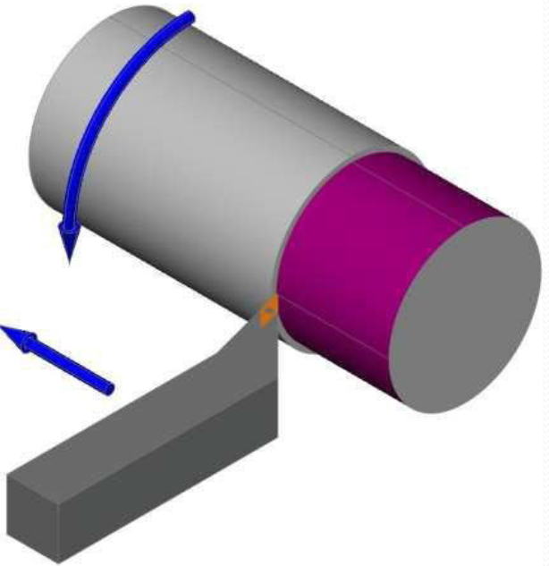
Turning
Turning: To produce cylindrical or conical surfaces externally.
In a turning operation, the workpiece is made to rotate about its axis in a lathe machine.
The tool is fed along the surface of the cylindrical workpiece to remove metal from the cylindrical workpiece.
In the turning operation, the Tool is fed parallel to the axis of rotation of the workpiece.
Notes:
Engagement of entire blade into cutting need higher forces. Therefore, inclined blade is used to reduce force.

Slide 8
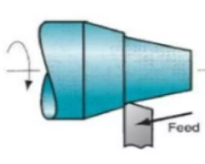
Taper turning
In the Taper turning operation, the tool is fed at an angle to the axis of rotation of the workpiece.
Taper turning is an operation in which a taper cylindrical surface, i.e., cone type surface, is produced.
Notes:
Engagement of entire blade into cutting need higher forces. Therefore, inclined blade is used to reduce force.

Slide 9
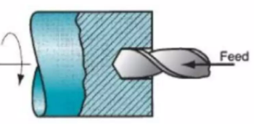
Drilling
Drilling is the operation of producing a cylindrical hole in a workpiece.
The tool used for drilling operations is called a drill.
Notes:
Engagement of entire blade into cutting need higher forces. Therefore, inclined blade is used to reduce force.

Slide 10
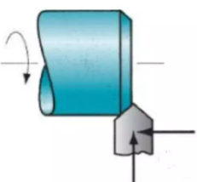
Chamfering
Chamfering is the operation of beveling the extreme end of a workpiece.
Chamfering operation is done to remove burrs from the edges of the workpiece.
Notes:
Engagement of entire blade into cutting need higher forces. Therefore, inclined blade is used to reduce force.

Slide 11
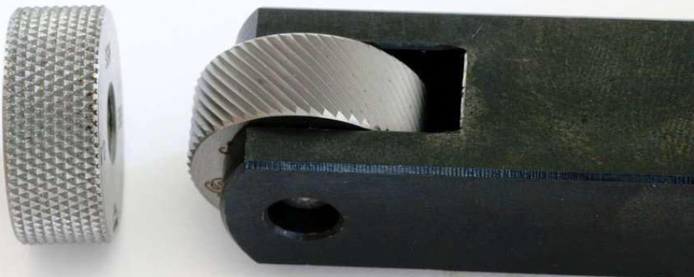
Knurling
Knurling is a process of embossing a diamond-shaped pattern on a workpiece’s surface.
The purpose of knurling is to provide an effective gripping surface on a workpiece.
Notes:
Engagement of entire blade into cutting need higher forces. Therefore, inclined blade is used to reduce force.

Slide 12
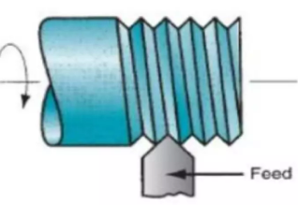
Threading
Thread cutting is the operation of producing threads on the outer surface of a cylindrical workpiece.
For thread cutting on the lathe, there is a definite relationship between the speeds of the job and the tool.
The relationship is obtained by gear ratio, which selection depends on the pitch of the job, the pitch of the lead screw, number of starts of the thread on the job.
Notes:
Engagement of entire blade into cutting need higher forces. Therefore, inclined blade is used to reduce force.

Slide 13
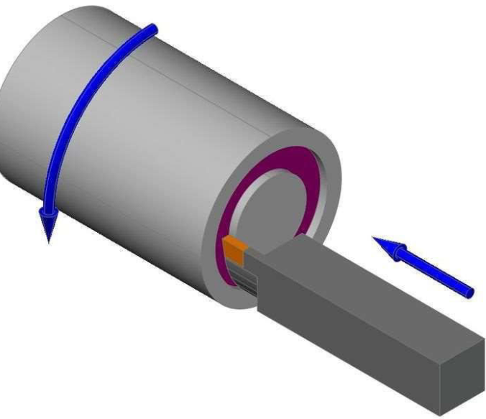
Face grooving
Face grooving: To cut a groove on the face of the job
Notes:
Engagement of entire blade into cutting need higher forces. Therefore, inclined blade is used to reduce force.

Slide 14
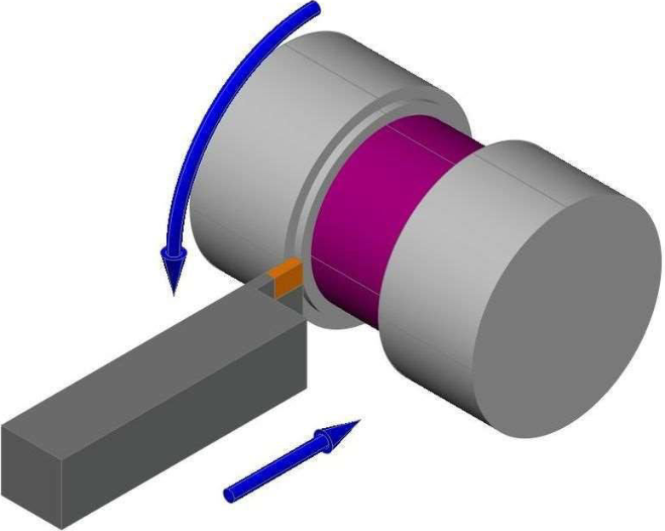
Grooving or Necking
Grooving or Necking: To reduce the diameter at desired portion
Notes:
Engagement of entire blade into cutting need higher forces. Therefore, inclined blade is used to reduce force.

Slide 15
Turning: To produce cylindrical or conical surfaces
Facing: To produce a flat surface at the end of the part (i.e., at the face)
Drilling: To produce a hole by fixing a drill bit and drill chuck assembly in the tailstock
Boring: To enlarge a hole made by a drilling process
Threading: To produce external or internal threads
Knurling: To produce cylindrical surfaces with some surface roughness
Notes:
Engagement of entire blade into cutting need higher forces. Therefore, inclined blade is used to reduce force.

Slide 16
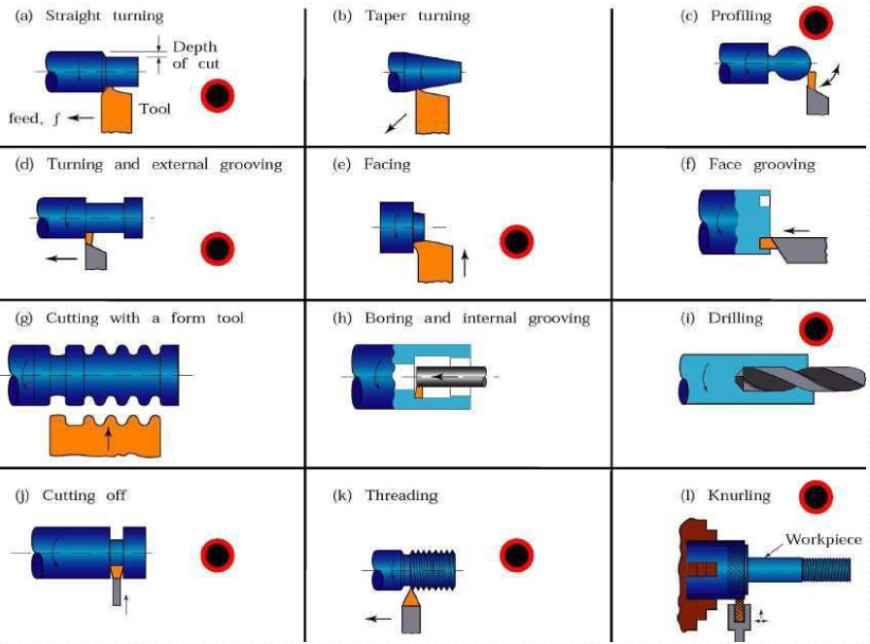
Schematic Representation of Various Lathe Operations
Notes:
Engagement of entire blade into cutting need higher forces. Therefore, inclined blade is used to reduce force.

